Slide 1

Administration: Treatment Goals + Strategies
DATE
PLACE

Slide 2
Who should take this training
Any staff who administer chemotherapy drugs.
These staff may include physicians and nurses.

Slide 3
Training Modules + Learning Objectives
Treatment Approaches
Treatment Plan Verification
Identify items that should be included in a treatment order.
Treatment Dose Calculations
Demonstrate the methods of dosing.
Explain the verification process of the orders.
Explain the sequence of treatment.
Define treatment approaches that utilize chemotherapies.

Slide 4
Treatment Approaches

Slide 5

Neoadjuvant Therapy
Treatment given as a first step to shrink a tumor before the main treatment, usually surgery, is given.
Adjuvant Therapy
Additional cancer treatment given after the primary treatment to lower the risk that the cancer will come back.
Immunosuppression
Suppression of the body's immune system and its ability to fight infections and other diseases.
Concurrent Chemoradiation
Treatment that combines chemotherapy with radiation therapy and is given at the same time.
Notes:
Neoadjuvant therapy
Treatment given as a first step to shrink a tumor before the main treatment, usually surgery, is given.
Examples of neoadjuvant therapy include chemotherapy, radiation therapy, and hormone therapy. It is a type of induction therapy.
Adjuvant therapy
Additional cancer treatment given after the primary treatment to lower the risk that the cancer will come back.
Adjuvant treatment may include chemotherapy, radiation therapy, hormone therapy, targeted therapy, or biological therapy.
Concurrent chemoradiation
Treatment that combines chemotherapy with radiation therapy and is given at the same time
Chemotherapy agents known to enhance the effects of radiation can be used concurrently with radiotherapy to have better radiation-induced local tumor control
Concurrent radiation can enhance the toxicity of normal tissue but is in some cancers superior to sequential therapy or radiotherapy alone
Conditioning therapy
The treatments used to prepare a patient for stem cell transplantation (a procedure in which a person receives blood stem cells, which make any type of blood cell). It helps make room in the patient’s bone marrow for new blood stem cells to grow, helps prevent the patient's body from rejecting the transplanted cells, and helps kill any cancer cells that are in the body.
A conditioning regimen may include chemotherapy, monoclonal antibody therapy, and radiation to the entire body.
Immunosuppression
Suppression of the body's immune system and its ability to fight infections and other diseases.
Immunosuppression may be deliberately induced with drugs, as in preparation for bone marrow or other organ transplantation, to prevent rejection of the donor tissue.

Slide 6
Maintaining the planned treatment schedule is important because systemic cancer treatments often have a narrow margin of therapeutic benefit.
Cycle 1
Cycle 2
Cycle 3
Notes:
Maintaining the planned treatment schedule is important because systemic cancer treatments often have a narrow margin of therapeutic benefit.
Minor adjustments below therapeutic doses can result in decreased tumor response, whereas minor adjustments above therapeutic doses can result in increased toxicity without increased benefit.

Slide 7

The treatment plan should be documented on the chemotherapy order
  It should include at minimum:
  Patient’s name
  A second patient identifier
  The date the order is written
  Regimen or protocol name and number
  Cycle number and day, when applicable
  All medications within the order set listed by using full generic names
  Drug dose written following standards of abbreviation, trailing zeros, and leading zeros
  The dose calculation
  Verification of medication sequence
This Photo by Unknown Author is licensed under CC BY-SA-NC
Notes:
It should include at minimum:
Patient’s name
A second patient identifier
The date the order is written
Regimen or protocol name and number
Cycle number and day, when applicable
All medications within the order set listed by using full generic names
Drug dose written following standards of abbreviation, trailing zeros, and leading zeros
*Medication sequencing: The order in which medication is given can influence the outcomes and the level of toxicity.

Slide 8
Treatment Dose Calculations

Slide 9
Several methods of dosing may be used depending on the prescribed drugs
Fixed doses
Weight-based dosing
Body Surface Area (BSA) based dosing
AUC-based dosing
Notes:
Several methods of dosing may be used depending on the prescribed drugs:
Fixed doses
Weight-based dosing
Body Surface Area (BSA) based dosing
AUC-based dosing

Slide 10

Fixed doses
    Often expressed in milligram (mg)
    No patient-based calculations are required
    Verification includes checking if the drugs prescribed fit the appropriate regimen for the type and stage of cancer
10
This Photo by Unknown Author is licensed under CC BY-NC-ND
Notes:
Fixed doses
Often expressed in milligram (mg)
No patient-based calculations are required
Verification includes checking if the drugs prescribed fit the appropriate regimen for the type and stage of cancer

Slide 11
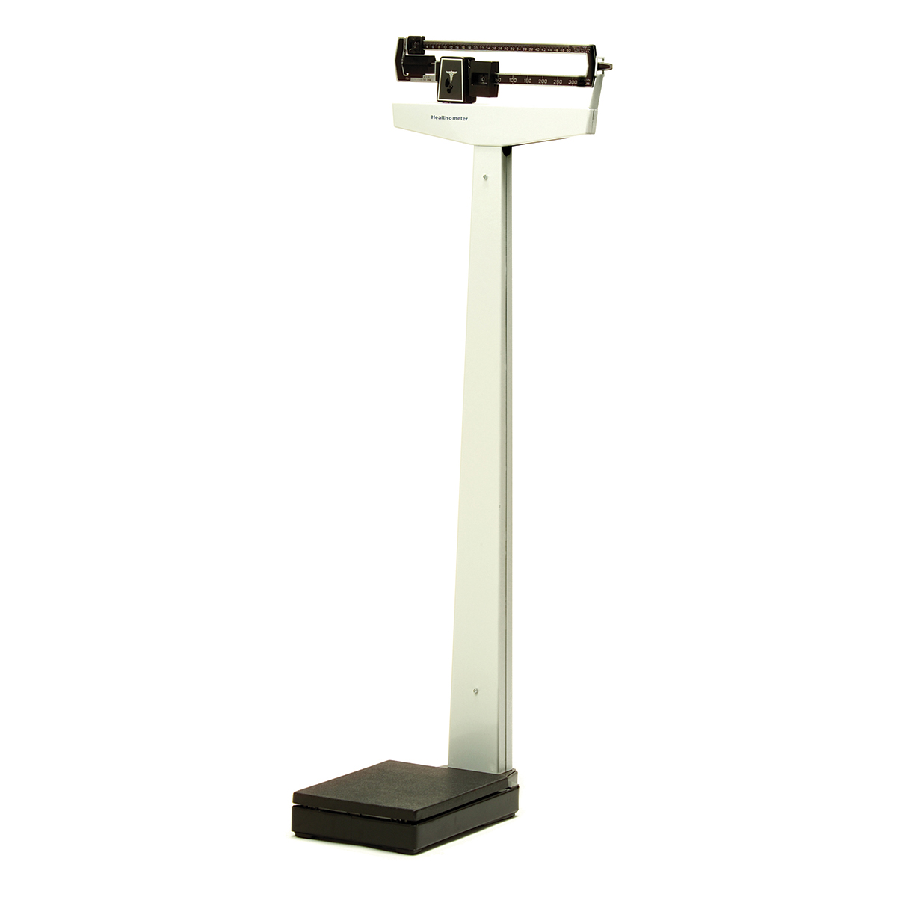
Weight-based dosing
    Often expressed as dose of drugs per unit of body weight (e.g. mg/kg)
    Doses are calculated using the accurate measured weight
This Photo by Unknown Author is licensed under CC BY-SA
11
Notes:
Weight-based dosing
Often expressed as dose of drugs per unit of body weight (e.g. mg/kg)
Doses are calculated using the accurate measured weight.

Slide 12

Body Surface Area (BSA) based dosing
    Often expressed as the total area of a person’s skin in square meters (m²)
    Current measured height and weight should be used. It should not be estimated or stated by the patient
    Most commonly used formula is the Mosteller equation
    Be aware of medication-specific circumstances that affect dosing based on BSA
$BSA (m2)=\sqrt{\frac{height in cm x weight in kg}{3,600}}$
or
BSA (m²) = $\sqrt{\frac{height in inches x weight in pounds}{3,131}}$
Notes:
Body Surface Area (BSA) based dosing
Often expressed as the total area of a person’s skin in square meters (m²)
A current measured height and weight should be used. It should not be estimated or stated by the patient.
Different methods of calculation, with slightly different outcomes.
Uniformity in formula used is relevant.
Most common used formula is the Mosteller equation
$BSA (m2)=\sqrt{\frac{height in cm x weight in kg}{3,600}}$
or
BSA (m²) = $\sqrt{\frac{height in inches x weight in pounds}{3,131}}$
Be aware of medication-specific circumstances that affect dosing based on BSA. E.g. vincristine dosing is based on BSA, but prescribers often cap the dose at a maximum of 2mg, regardless of the BSA, to reduce potential neurologic toxicities

Slide 13
AUC-based dosing
AUC stands for ‘area under the concentration-versus-time curve’
Often used to determine carboplatin doses
AUC refers to the amount of drug exposure over time or the total drug concentration in plasma over a period of time
Notes:
AUC-based dosing
Often used to determine carboplatin doses
AUC stands for ‘area under the concentration-versus-time curve’
AUC refers to the amount of drug exposure over time or the total drug concentration in plasma over a period of time
.

Slide 14

AUC of carboplatin accounts for:
Age
Gender
Weight
Renal function
  Carboplatin drug clearance is strongly correlated with renal function
This Photo by Unknown Author is licensed under CC BY-SA
Notes:
AUC of carboplatin accounts for age, gender, weight and renal function. Carboplatin drug clearance is strongly correlated with renal function

Slide 15

Before the AUC can be calculated, the estimated creatinine clearance (estCrCl) needs to be calculated or the actual glomerular filtration rate (GFR) needs to be established.
The GFR is rarely used because it requires a 24 hours urine collection.
This Photo by Unknown Author is licensed under CC BY-SA-NC
Notes:
Before the AUC can be calculated, the estimated creatinine clearance (estCrCl) needs to be calculated or the actual glomerular filtration rate (GFR) needs to be established. The GFR is rarely used because it requires a 24 hours urine collection.

Slide 16
There are several formulas to obtain the value of the estCrCl, most commonly used is the Cockcroft-Gault formula.

Slide 17
If different formulas are used, the outcomes can show significantly different results.
For male patients the Cockcroft-Gault formula is: $estCrCl (ml/min)= \frac{\left(140−age\right) x (weight in kg)}{72 x serum creatinine (mg/dl)}$
For male patients the Cockcroft-Gault formula is: 𝑒𝑠𝑡𝐶𝑟𝐶𝑙 (𝑚𝑙/𝑚𝑖𝑛)= ((140−𝑎𝑔𝑒) 𝑥 (𝑤𝑒𝑖𝑔ℎ𝑡 𝑖𝑛 𝑘𝑔))/(72 𝑥 𝑠𝑒𝑟𝑢𝑚 𝑐𝑟𝑒𝑎𝑡𝑖𝑛𝑖𝑛𝑒 (𝑚𝑔/𝑑𝑙))
For female patients the Cockcroft-Gault formula is:$estCrCl (ml/min)= \frac{\left(140−age\right) x \left(weight in kg\right)x(0.85)}{72 x serum creatinine (mg/dl)}$
For female patients the Cockcroft-Gault formula is:𝑒𝑠𝑡𝐶𝑟𝐶𝑙 (𝑚𝑙/𝑚𝑖𝑛)= ((140−𝑎𝑔𝑒) 𝑥 (𝑤𝑒𝑖𝑔ℎ𝑡 𝑖𝑛 𝑘𝑔)𝑥(0.85))/(72 𝑥 𝑠𝑒𝑟𝑢𝑚 𝑐𝑟𝑒𝑎𝑡𝑖𝑛𝑖𝑛𝑒 (𝑚𝑔/𝑑𝑙))
Notes:
If different formulas are used, the outcomes can show significantly different results.
For male patients the Cockcroft-Gault formula is: (53)
$$estCrCl (ml/min)= \frac{\left(140−age\right) x (weight in kg)}{72 x serum creatinine (mg/dl)}$$
For female patients the Cockcroft-Gault formula is: (53)
$$estCrCl (ml/min)= \frac{\left(140−age\right) x \left(weight in kg\right)x(0.85)}{72 x serum creatinine (mg/dl)}$$

Slide 18

After the estCrCl or GFR are determined, the Calvert formula can be used to calculate the dose of carboplatin.
The target AUC is specified in the order.
$$Dose of carboplatin \left(mg\right)=\left(target AUC\right) x (estCrCl+25)$$
Notes:
After the estCrCl or GFR are determined, the Calvert formula can be used to calculate the dose of carboplatin. The target AUC is specified in the order.
$$Dose of carboplatin \left(mg\right)=\left(target AUC\right) x (estCrCl+25)$$
Changes in how laboratories determine serum creatinine may result in underestimation of serum creatinine when it is low. This can result in an overestimation of CrCl and even an overdosing of carboplatin, with the risk of increased toxicity without added clinical benefit. (23,54,55)
For this reason, the US-FDA has recommended capping estCrCl at 125ml/min in patients with a normal renal function.
When the actual GFR is used in calculating the carboplatin dose, dose capping is not required.
Carboplatin dose capping using Estimated Creatinine Clearance
Dose of carboplatin (mg) = (target AUC) x (estCrCl+25)
EstCrCl capped at 125 ml/min
Maximum doses for sample target AUCs:
Target AUC 6: maximum carboplatin dose = 6 x (125+25) = 900mg
Target AUC 5: maximum carboplatin dose = 5 x (125+25) = 750mg
Target AUC 4: maximum carboplatin dose = 4 x (125+25) = 600mg

Slide 19
The dose calculation should include:
    The calculation methodology
    The variables used to calculate the dose
    The frequency at which the variables are re-evaluated
    The changes in the values that prompt confirmation of dosing
    Date of administration
    Route of administration
    Allergies
    Supportive care treatments that are appropriate for the regimen, including premedication, hydration, growth factors, and hypersensitivity medication
    Parameters that would require holding or modifying dose, for example, laboratory values, diagnostic test results, and patient’s clinical status
    Sequencing of drug administration, when applicable
    Rate of drug administration when applicable
    An explanation of time limitation, such as the number of cycles for which the order is valid
Notes:
The dose calculation including:
The calculation methodology
The variables used to calculate the dose
The frequency at which the variables are re-evaluated
The changes in the values that prompt confirmation of dosing
Date of administration
Route of administration
Allergies
Supportive care treatments that are appropriate for the regimen, including premedications, hydration, growth factors and hypersensitivity medication
Parameters that would require holding or modifying dose, for example, laboratory values, diagnostic test results, and patient’s clinical status
Sequencing of drug administration, when applicable
Rate of drug administration when applicable
An explanation of time limitation, such as the number of cycles for which the order is valid

Slide 20
Treatment Plan Verification

Slide 21

A licensed pharmacist verifies all orders before administration of chemotherapy
A second person – a practitioner or other personnel approved to prepare or administer chemotherapy- performs three independent verifications
This Photo by Unknown Author is licensed under CC BY-SA
Notes:
A licensed pharmacist verifies all orders before administration or dispensing chemotherapy for pediatric patients aged <18 years.
A second person – a practitioner or other personnel approved to prepare or administer chemotherapy- performs three independent verifications.

Slide 22
Before preparation, a second person verifies:
Two patient identifiers
Drug name
Drug dose
Route of administration
Rate of administration
The calculation for dosing
Treatment cycle and day of cycle
Notes:
Before preparation, a second person verifies:
Two patient identifiers
Drug name
Drug dose
Route of administration
Rate of administration
The calculation for dosing, including the variables used in this calculation
Treatment cycle and day of cycle.

Slide 23
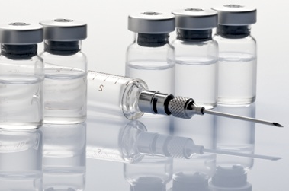
Upon preparation, a second person verifies:
The drug vial(s)
Concentration
Drug volume or weight
Diluent type and volume
Administration fluid type
This Photo by Unknown Author is licensed under CC BY-ND
Notes:
Upon preparation, a second person verifies:
The drug vial(s)
Concentration
Drug volume or weight
Diluent type and volume, when applicable
Administration fluid type, volume and tubing

Slide 24

Before each chemotherapy administration, at least two practitioners verify and document the accuracy of the following elements:
This Photo by Unknown Author is licensed under CC BY-SA
    Drug name
    Drug dose
    Infusion volume or drug volume when prepared in a syringe
    Rate of administration
    Route of administration
    Expiration dates and/or times
    Appearance and physical integrity
Reference 3
Notes:
Before each chemotherapy administration, at least two practitioners verify and document the accuracy of the following elements:
Drug name
Drug dose
Infusion volume or drug volume when prepared in a syringe
Rate of administration
Route of administration
Expiration dates and/or times
Appearance and physical integrity

Slide 25

If orders are unclear or leave room for interpretation, clarification needs to be obtained from the prescriber and adequately documented.
Reference 2,4
Notes:
If orders are unclear or leave room for interpretation, clarification needs to be obtained from the prescriber and adequately documented.

Slide 26
References
NCI Dictionary of Cancer Terms [Internet]. National Cancer Institute. [cited 2018 Jun 28].
Polovich M, Olsen M, LeFebvre K. Chemotherapy and biotherapy guidelines and recommendations for practice. 4th ed. Oncology Nursing Society; 2014.
Neuss MN, Gilmore TR, Belderson KM, Billett AL, Conti-Kalchik T, Harvey BE, et al. 2016 Updated American Society of Clinical Oncology/Oncology Nursing Society Chemotherapy Administration Safety Standards, Including Standards for Pediatric Oncology. J Oncol Pract. 2016 Dec;12(12):1262–71.
Levine. Chemotherapy (in J.Eggert (ed.), Cancer Basics. Pittsburgh: Oncology Nursing Society; pp. 195-215.
Kouno T, Katsumata N, Mukai H, Ando M, Watanabe T. Standardization of the body surface area (BSA) formula to calculate the dose of anticancer agents in Japan. Jpn J Clin Oncol. 2003 Jun;33(6):309–13.
Creatinine Clearance Estimate by Cockcroft-Gault Equation Calculator [Internet]. [cited 2018 Jul 19].

